Slide 1

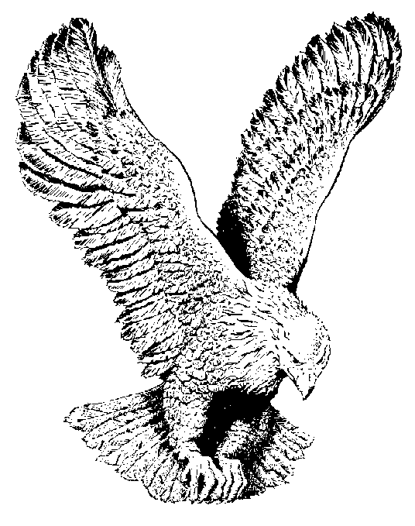
LORD I’M COMING NOW
Lord I’m coming now to Thee
Lay Thy nail scarred hand on me
Let Thy healing virtue flow
And I shall be made whole.

